Slide 1
Chess With Min Max Algorithm
Fardin Mohammed, Filip Matracki, Ivan Matyazh

Slide 2
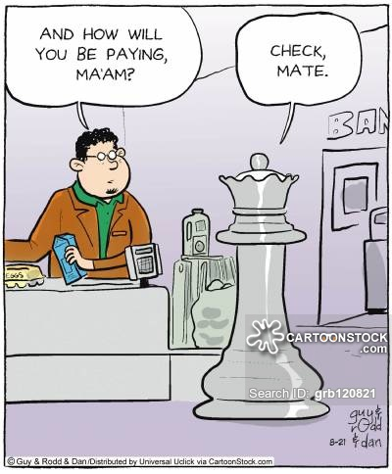
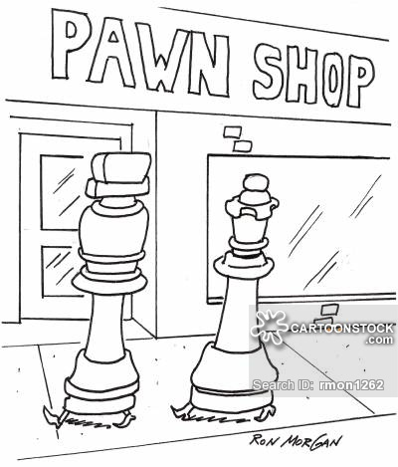
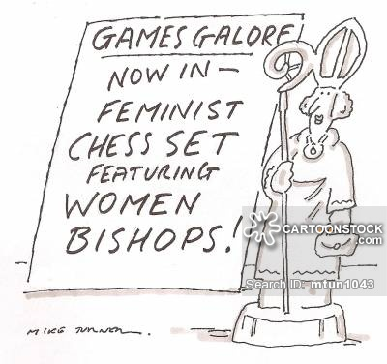
Some Funny Jokes

Slide 3
A Short Introduction
A WPF(Windows Presentation Foundation) application implemented in C#.
The application is used to play chess with Min-Max algorithm AI bot.
The application is used to test the boundaries of Min-Max algorithm in different depths.

Slide 4
A Short Introduction
The application has two game modes:
Human vs Human
Human vs AI (Artificial Intelligence)

Slide 5
Mechanism
Min-Max algorithm is used to determine score in a zero sum game.
We use Min-Max to maximize the score of one side without knowing about the other side’s moves but by evaluating its current possibilities.
We use an evaluation function to find the score for the current state of each side and try to maximize for one side.

Slide 6
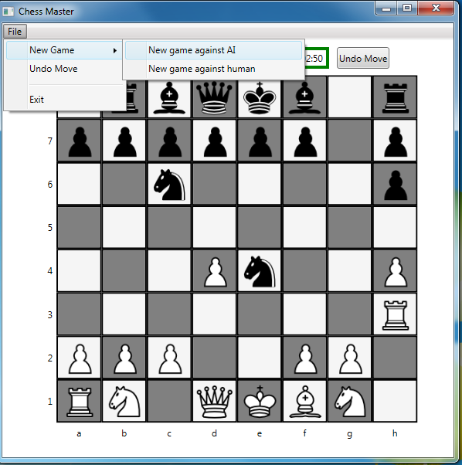
Setup the game

Slide 7
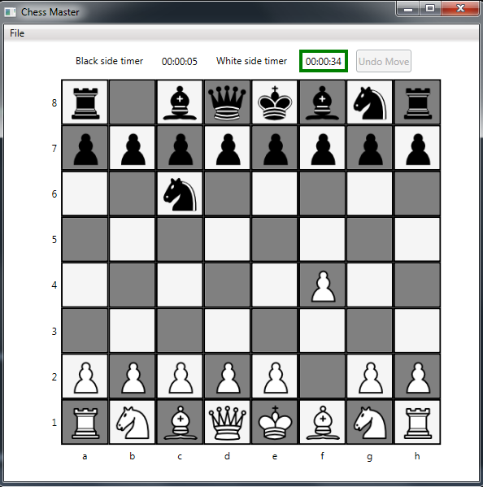
Moves In Progress

Slide 8
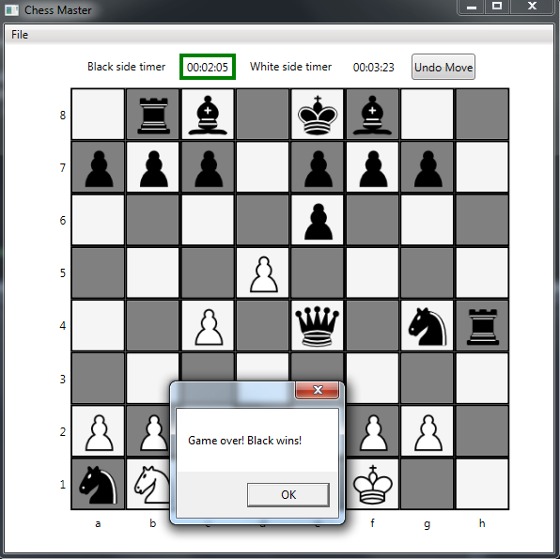
AI wins

Slide 9
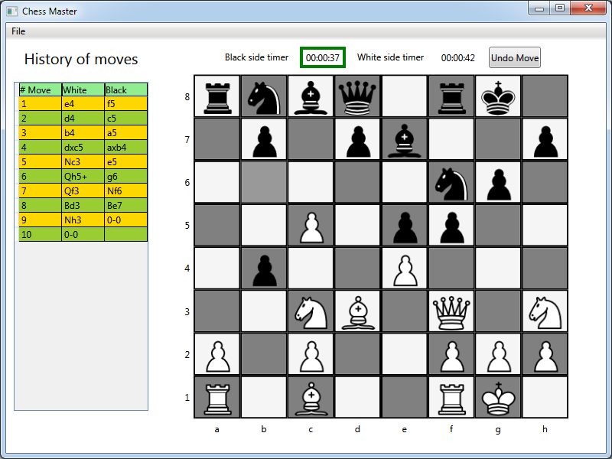
Project Features. Move logging

Slide 10
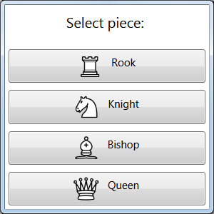
Project Features. Piece Promotion

Slide 11
Results
Our Min-Max algorithm has the following features:
Depth is equal to 3
Average time of the AI move is around 5-10 seconds
Aimed at passive play
But can easily take opportunity from player’s mistake

Slide 12
Conclusions
Our application has decent AI for the beginner or even for the average chess player.
It rarely makes mistakes, however it can be won be by a player, who thinks more than 5 steps ahead.

Slide 13
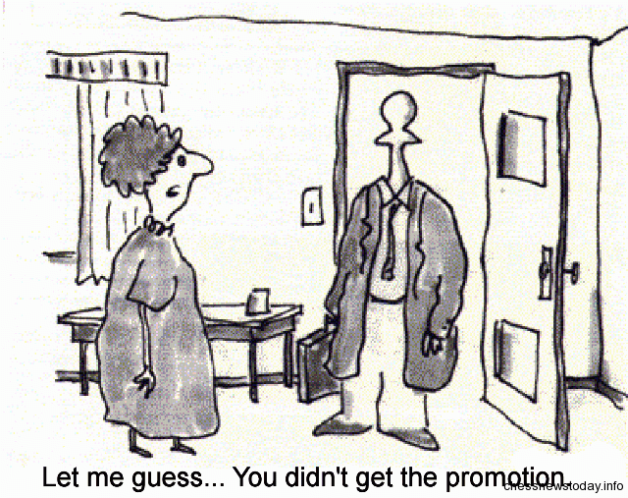
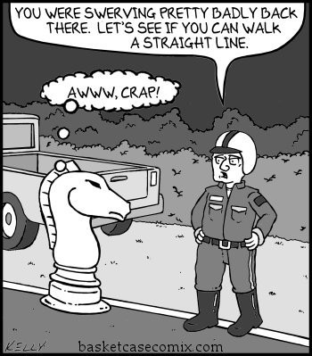
Let me finish with joke

